Slide 1
Stepping Into the Past Preserving the Future

Slide 2
NEWFOUNDLAND

Slide 3
Newfoundland’S Heritage Districts
Cable Bay ( Bay Roberts )
Harbour Grace
Heart Content
Port Union
Woody Point
Tilting

Slide 4
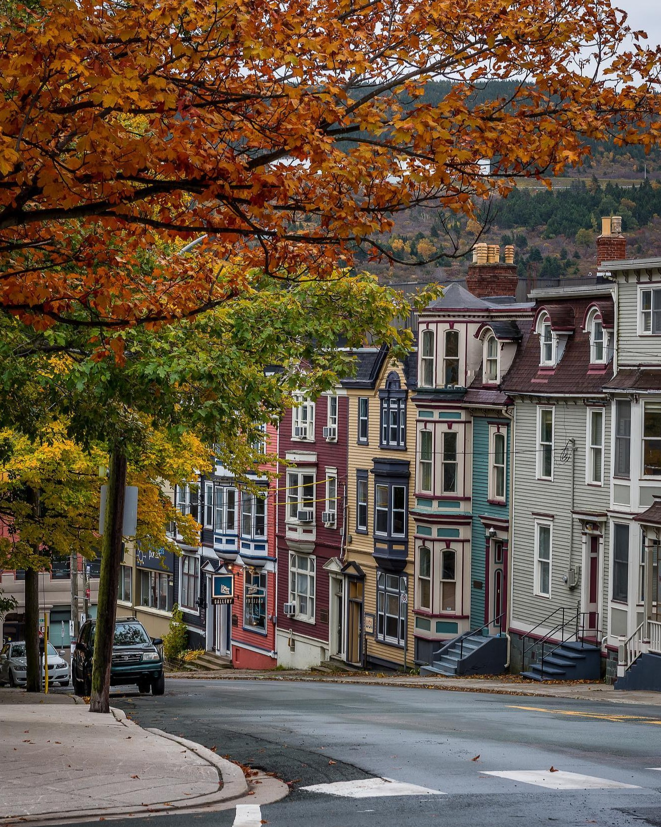

Slide 5
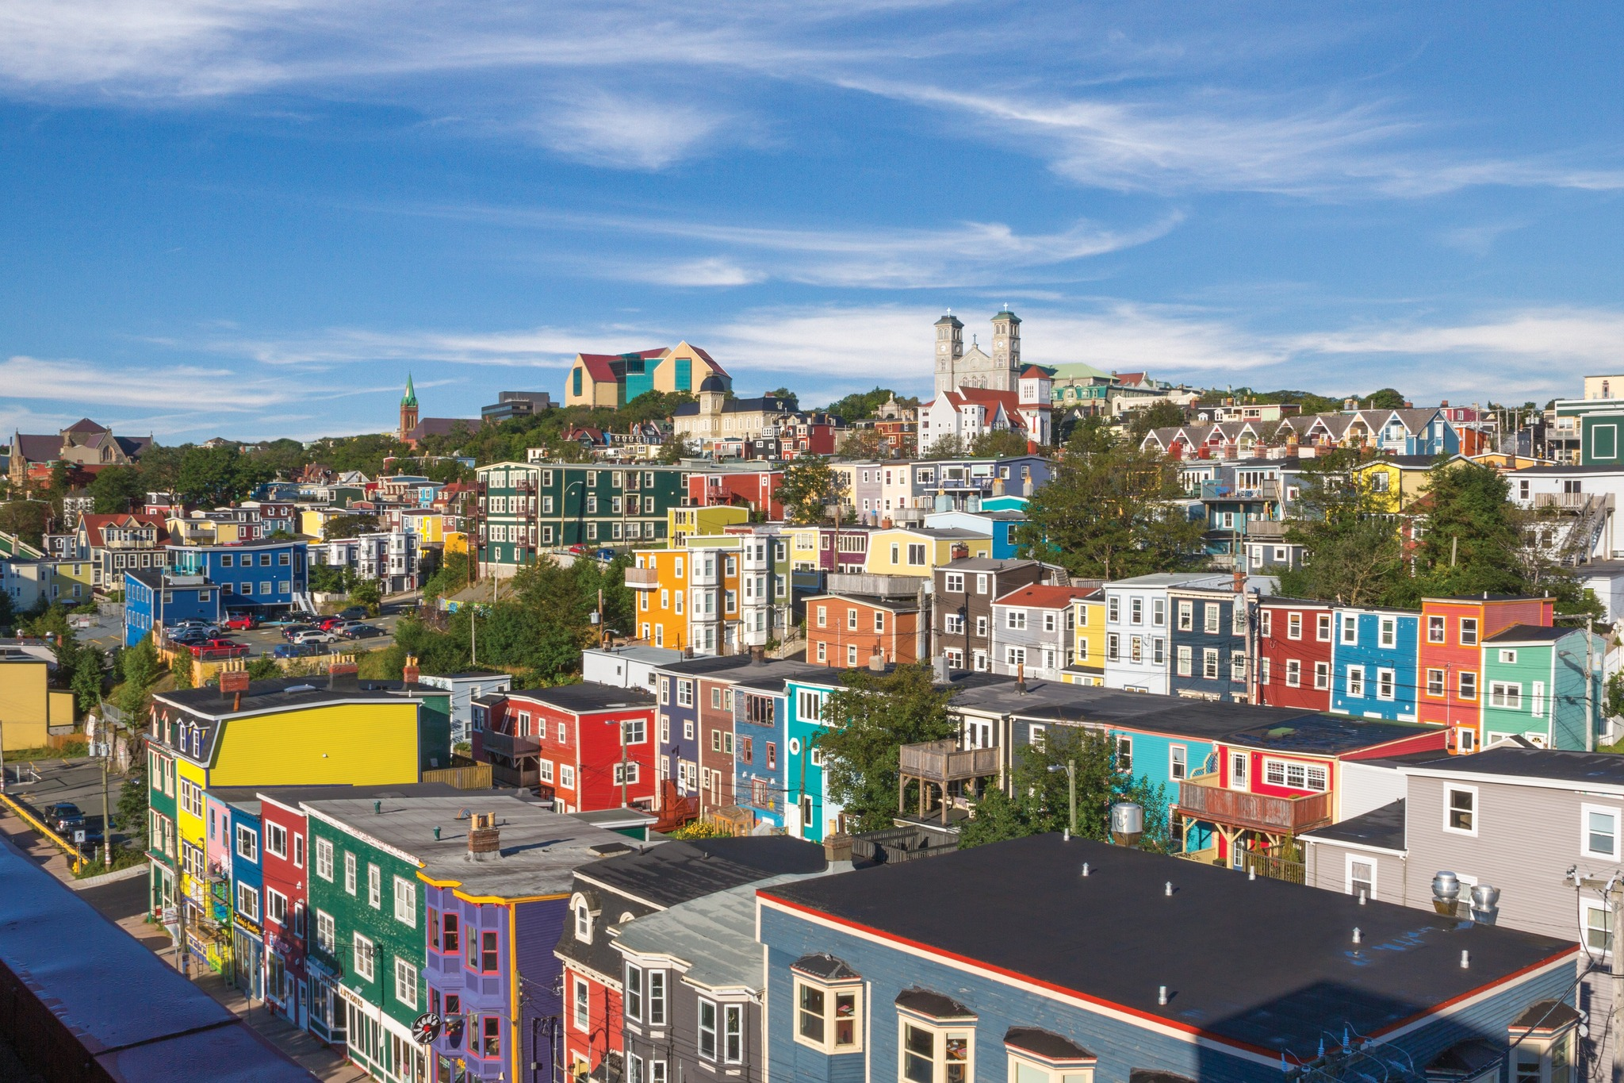

Slide 6
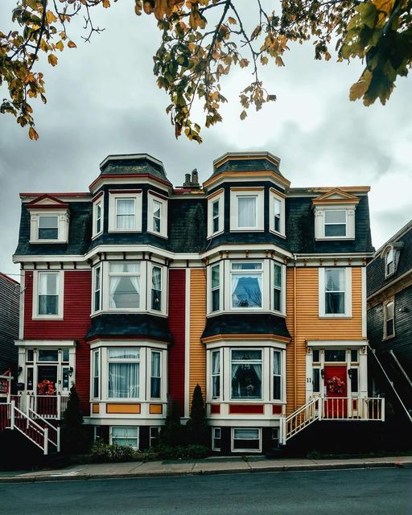

Slide 7


Slide 8
Main Street Program 1970
John Stewart Businessman Visionary
Secured Federal grants to improve main streets
Wooden siding on downtown buildings were removed.
And…..

Slide 9
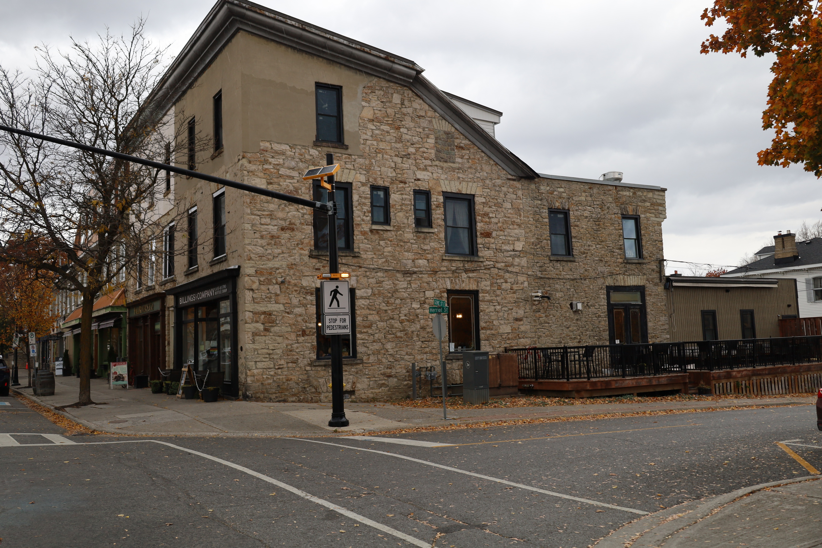

Slide 10
Perth’s Downtown Heritage District

Slide 11
Heritage Character Statement
The Downtown Perth Heritage Conservation District encompasses the downtown core, which includes a vibrant commercial and civic centre that can be linked to several key periods in the town’s development. This history of the Town’s development is reflected in both the landscape and built form found within the downtown core. These elements create a narrative throughout the District, mirroring the settlement, growth, and prosperity of the Town.

Slide 13
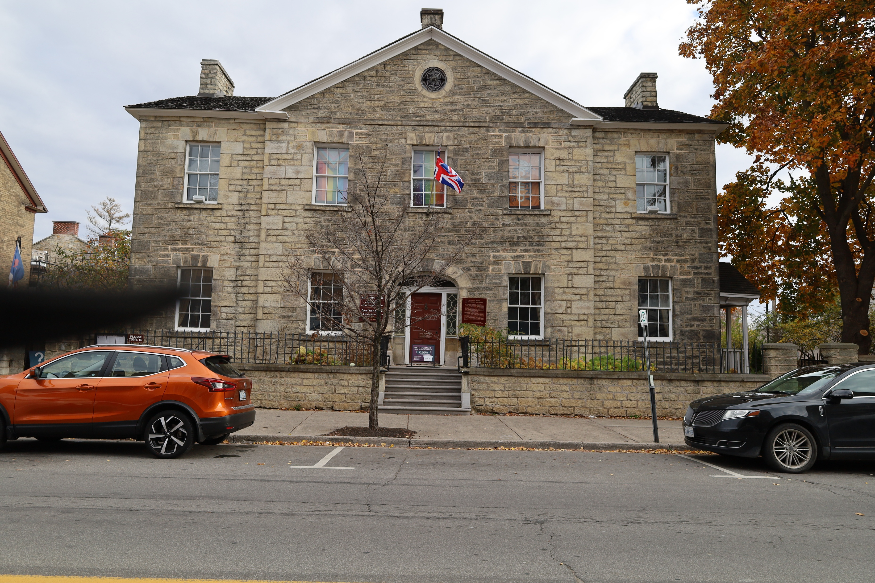

Slide 14
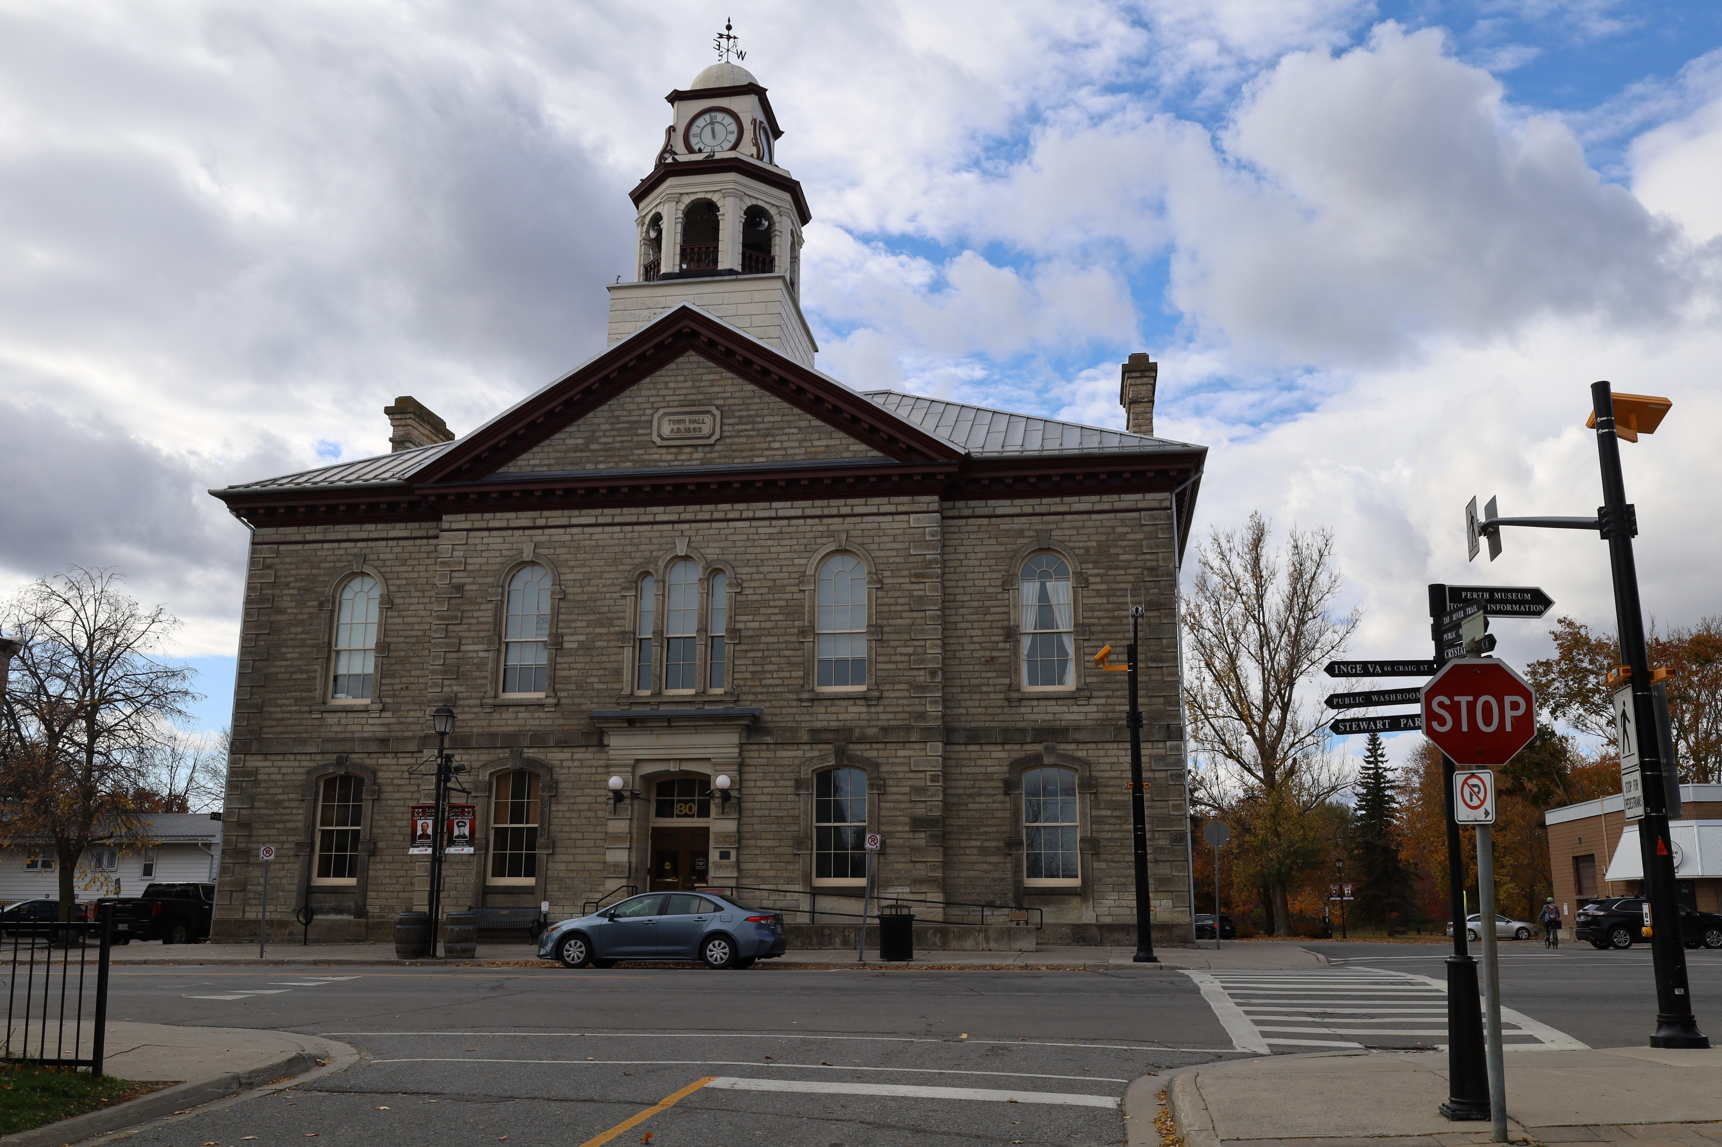

Slide 15
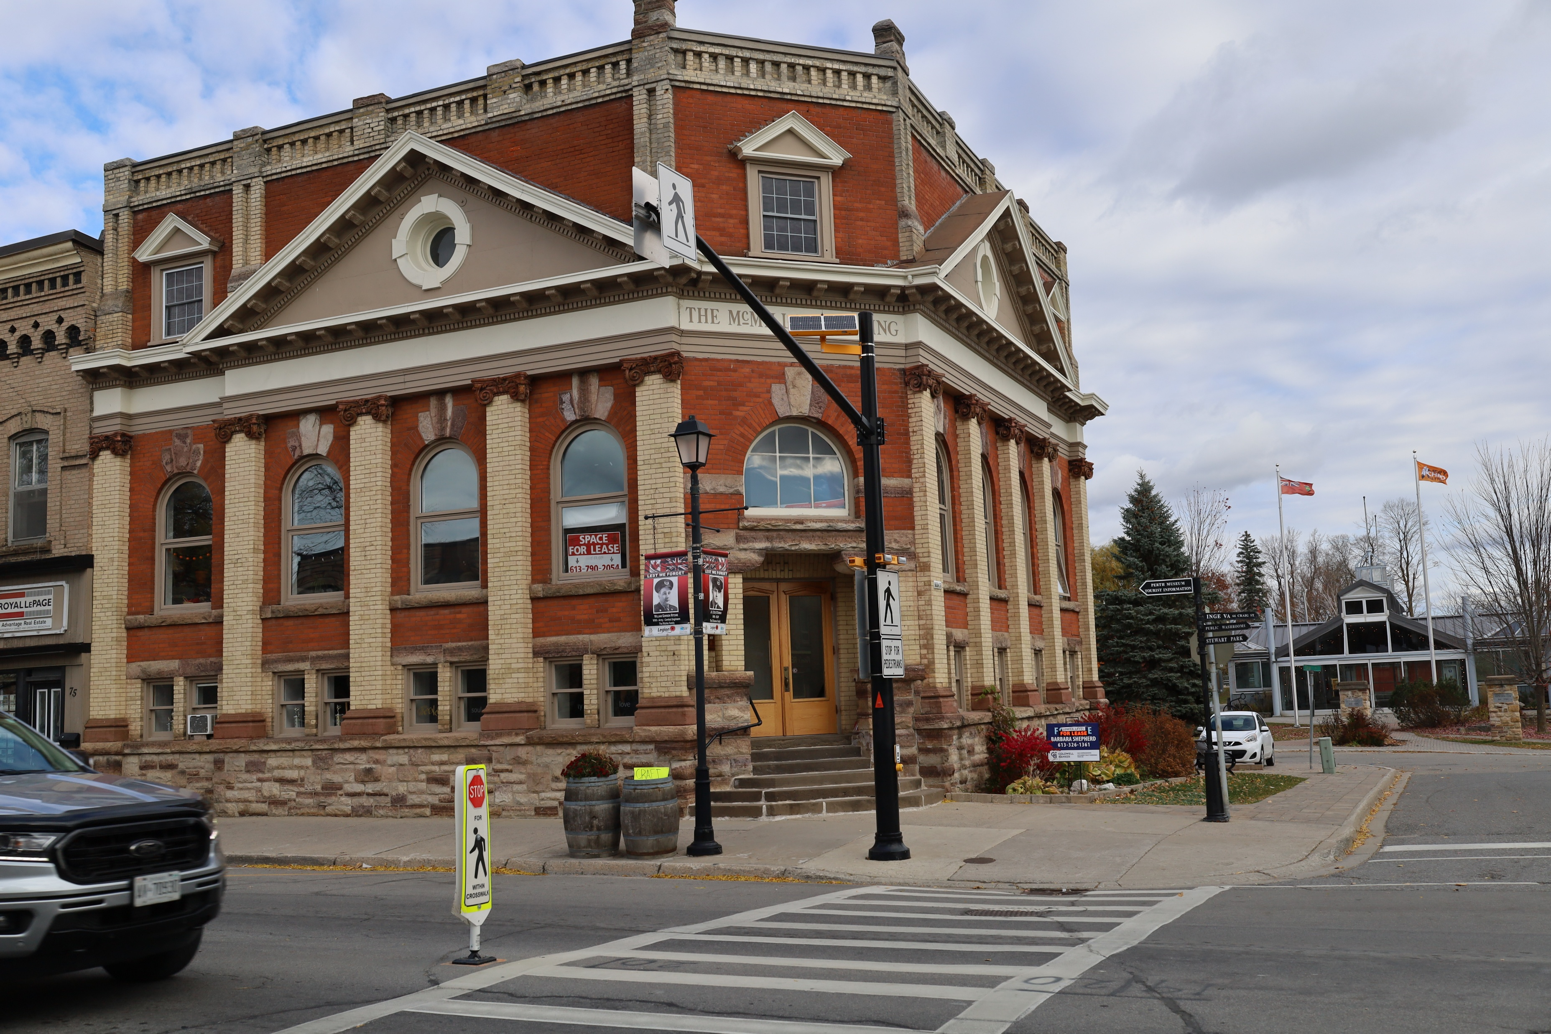

Slide 16
Heritage Conservation Districts enable the preservation of key functional and visual attributes that convey or have a connection to the collective history of the area in which they are located.
A Heritage Conservation District can include heritage buildings, sites, structures, designed and natural landscapes, all linked through aesthetic, historical and socio-cultural contexts.
It does not mean that an area is ‘frozen’ in time or intended to be restored to a specific historical period or style.

Slide 17
The streetscape is the focus of a Heritage Conservation District. As a result, policies and guidelines are put in place to provide direction regarding the types of alterations, additions or new construction that will be considered appropriate.
Guidelines are provided to assist with maintaining and repairing certain built forms or landscape elements. A Heritage Conservation District does not refer to or affect the interior of a building, only the façade.

Slide 18
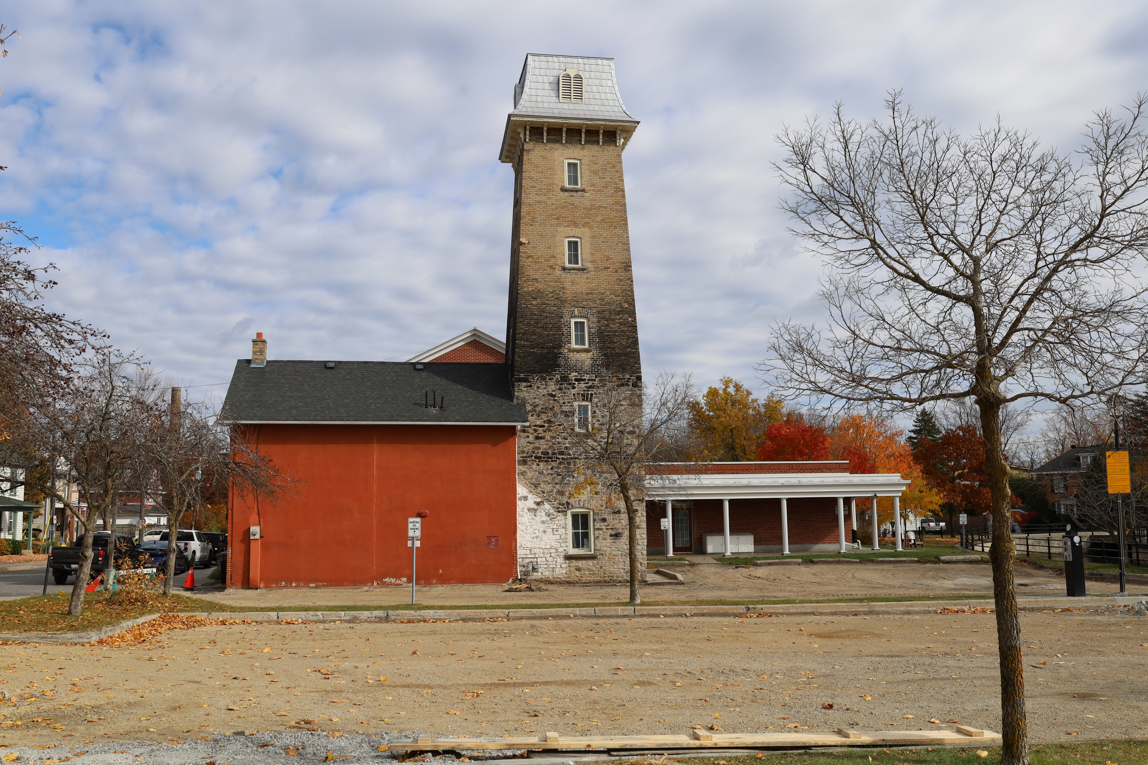

Slide 20
Official Plan Headings

Slide 22
Benefits of a Heritage Conservation District
➢ The protection and management of heritage assets (architecture, landscape and history);
➢ Additional information and guidance to property owners who are undertaking restoration, renovation and redevelopment;
➢ Potential financial assistance (through grants, tax relief programs) for renovation and restoration;
➢ Source of new promotion and tourism initiatives (walking tours, interpretive features); and
➢ Increased community stability.
A Heritage Conservation District provides an opportunity to retain and enhance an area’s most unique and attractive features for the overall benefit of property owners and the community as a whole.

Slide 23
Permits Required
In general, heritage alteration permits ARE REQUIRED for the following types of work:
➢ Additions to any façades visible from public areas (streets, laneways, slypes, open space, parks);
➢ New buildings constructed on vacant properties, as integrated redevelopment projects or to replace existing buildings for any reason;
➢ Major alterations to or replacement of features such as doors, windows, porches, decorative trim on the street-facing portion of a building, where the feature being altered or replaced will be of different style, materials or proportions than existing;
➢ Commercial signage affixed to buildings in accordance with the Town Signage By-law; and

Slide 24
Concerns
Property Values
Cost for insurance
Cost of renovations
Interfering the creative process. Painting.
“I want neon……..”

Slide 25
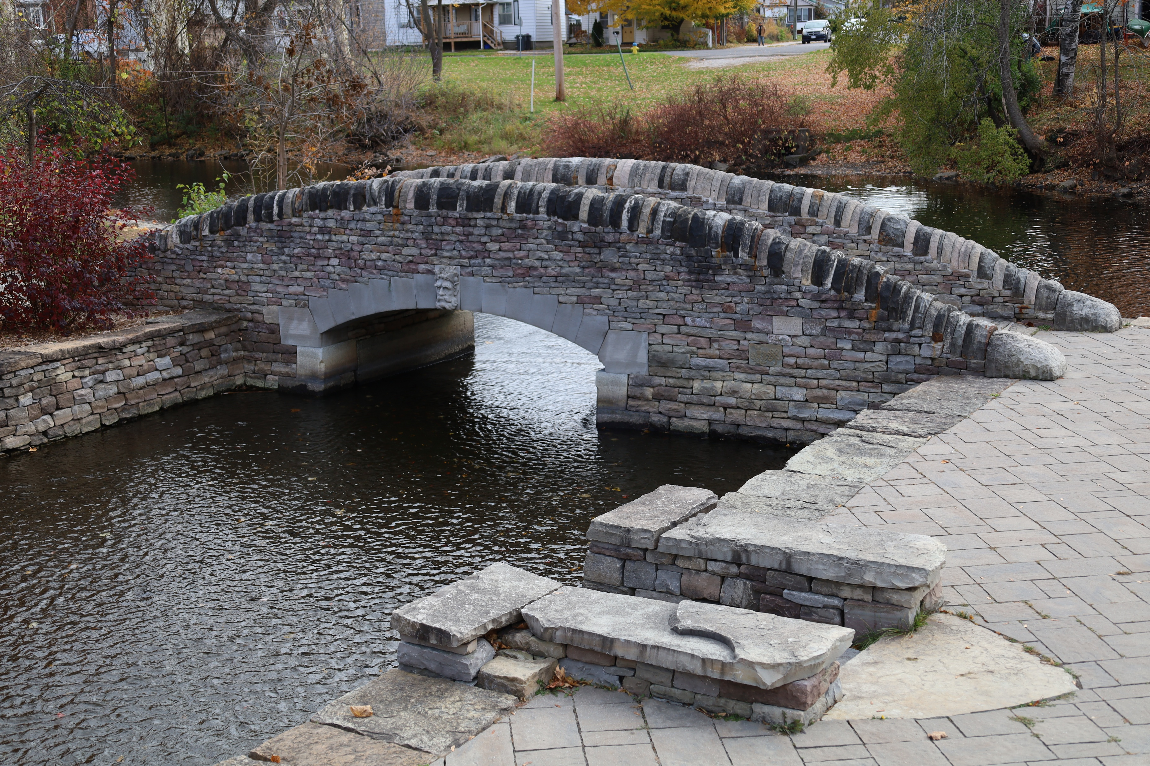
Thinking over the horizon

Slide 26
Whats the alternative.

Slide 27
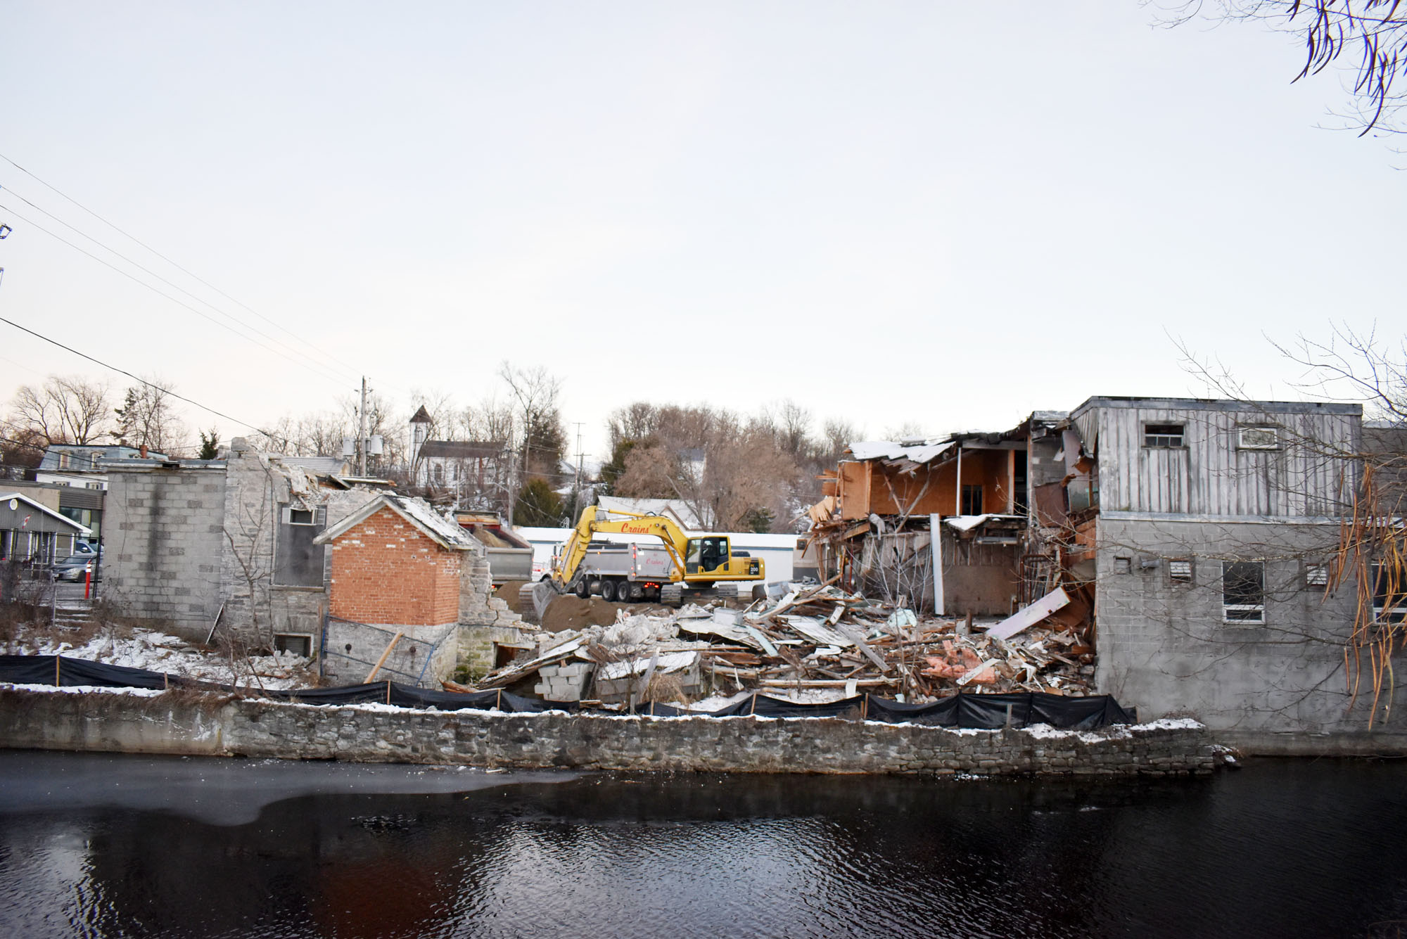

Slide 28
Distance is measured in miles, love is measured in heartbeats.

Slide 29
A Stewardship Guide to the Downtown Perth Heritage Conservation District.

Slide 30
Thank you.

